Slide 1
Transmission Media

Slide 2
Overview
Guided - wire
Unguided - wireless
Characteristics and quality determined by medium and signal
For guided, the medium is more important
For unguided, the bandwidth produced by the antenna is more important
Key concerns are data rate and distance

Slide 3
Design Factors
Bandwidth
  Higher bandwidth gives higher data rate
Transmission impairments
  Attenuation
Interference
Number of receivers
  In guided media
  More receivers (multi-point) introduce more attenuation

Slide 4
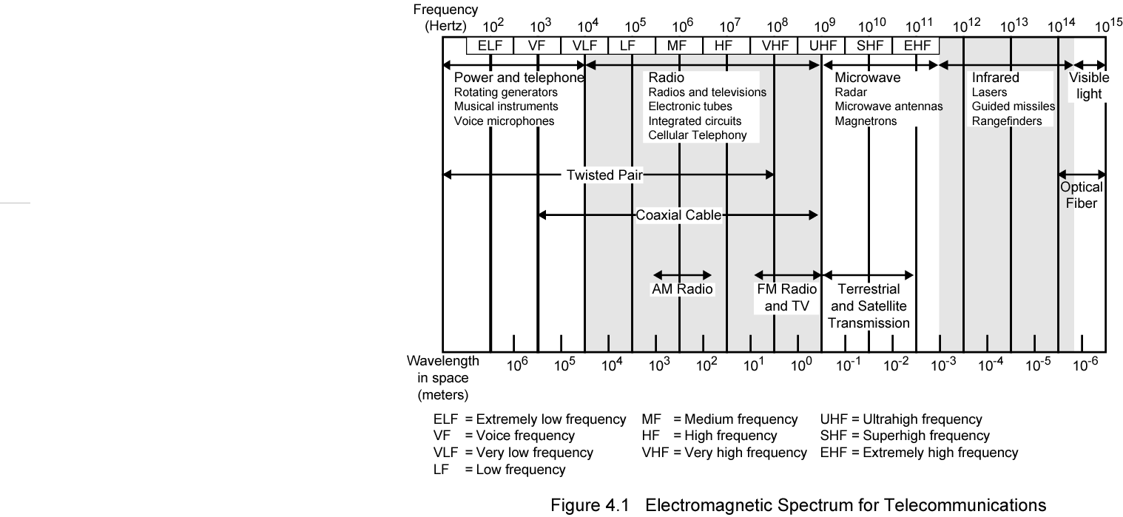
Electromagnetic Spectrum

Slide 5
Guided Transmission Media
Twisted Pair
Coaxial cable
Optical fiber

Slide 6
Transmission Characteristics of Guided Media
Frequency Range
Typical Attenuation
Typical Delay
Repeater Spacing
Twisted pair (with loading)
0 to 3.5 kHz
0.2 dB/km @ 1 kHz
50 µs/km
2 km
Twisted pairs (multi-pair cables)
0 to 1 MHz
0.7 dB/km @ 1 kHz
5 µs/km
2 km
Coaxial cable
0 to 500 MHz
7 dB/km @ 10 MHz
4 µs/km
1 to 9 km
Optical fiber
186 to 370 THz
0.2 to 0.5 dB/km
5 µs/km
40 km

Slide 7
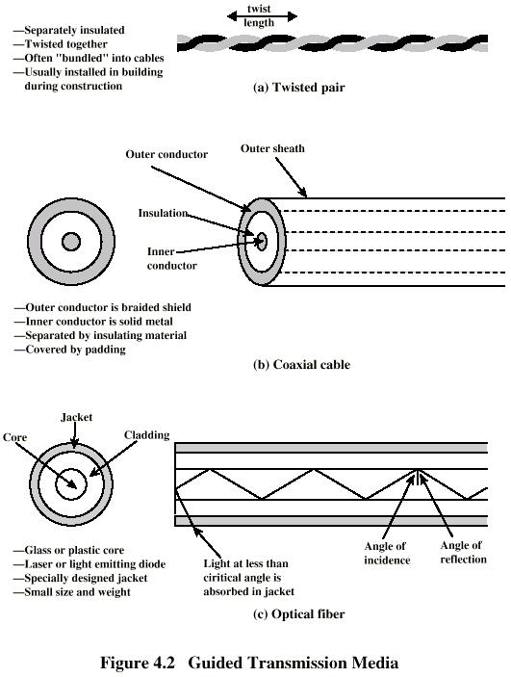
Twisted Pair

Slide 8
Twisted Pair - Applications
Most common medium
Telephone network
  Between house and local exchange (subscriber loop)
Within buildings
  To private branch exchange (PBX)
For local area networks (LAN)
  10Mbps or 100Mbps

Slide 9
Twisted Pair - Pros and Cons
Cheap
Easy to work with
Low data rate
Short range

Slide 10
Twisted Pair - Transmission Characteristics
Analog
  Amplifiers every 5km to 6km
Digital
  Use either analog or digital signals
  repeater every 2km or 3km
Limited distance
Limited bandwidth (1MHz)
Limited data rate (100MHz)
Susceptible to interference and noise

Slide 11
Near End Crosstalk
Coupling of signal from one pair to another
Coupling takes place when transmit signal entering the link couples back to receiving pair
i.e. near transmitted signal is picked up by near receiving pair

Slide 12
Unshielded and Shielded TP
Unshielded Twisted Pair (UTP)
  Ordinary telephone wire
  Cheapest
  Easiest to install
  Suffers from external EM interference
Shielded Twisted Pair (STP)
  Metal braid or sheathing that reduces interference
  More expensive
  Harder to handle (thick, heavy)

Slide 13
UTP Categories
Cat 3
  up to 16MHz
  Voice grade found in most offices
  Twist length of 7.5 cm to 10 cm
Cat 4
  up to 20 MHz
Cat 5
  up to 100MHz
  Commonly pre-installed in new office buildings
  Twist length 0.6 cm to 0.85 cm
Cat 5E (Enhanced) –see tables
Cat 6
Cat 7

Slide 14
Comparison of Shielded and Unshielded Twisted Pair
Attenuation (dB per 100 m)
Near-end Crosstalk (dB)
Frequency (MHz)
Category 3 UTP
Category 5 UTP
150-ohm STP
Category 3 UTP
Category 5 UTP
150-ohm STP
1
2.6
2.0
1.1
41
62
58
4
5.6
4.1
2.2
32
53
58
16
13.1
8.2
4.4
23
44
50.4
25
—
10.4
6.2
—
41
47.5
100
—
22.0
12.3
—
32
38.5
300
—
—
21.4
—
—
31.3

Slide 15
Twisted Pair Categories and Classes
Category 3 Class C
Category 5 Class D
Category 5E
Category 6 Class E
Category 7 Class F
Bandwidth
16 MHz
100 MHz
100 MHz
200 MHz
600 MHz
Cable Type
UTP
UTP/FTP
UTP/FTP
UTP/FTP
SSTP
Link Cost (Cat 5 =1)
0.7
1
1.2
1.5
2.2

Slide 16
Coaxial Cable

Slide 17
Coaxial Cable Applications
Most versatile medium
Television distribution
  Ariel to TV
  Cable TV
Long distance telephone transmission
  Can carry 10,000 voice calls simultaneously
  Being replaced by fiber optic
Short distance computer systems links
Local area networks

Slide 18
Coaxial Cable - Transmission Characteristics
Analog
  Amplifiers every few km
  Closer if higher frequency
  Up to 500MHz
Digital
  Repeater every 1km
  Closer for higher data rates

Slide 19
Optical Fiber

Slide 20
Optical Fiber - Benefits
Greater capacity
  Data rates of hundreds of Gbps
Smaller size & weight
Lower attenuation
Electromagnetic isolation
Greater repeater spacing
  10s of km at least

Slide 21
Optical Fiber - Applications
Long-haul trunks
Metropolitan trunks
Rural exchange trunks
Subscriber loops
LANs

Slide 22
Optical Fiber - Transmission Characteristics
Act as wave guide for 10¹⁴ to 10¹⁵ Hz
  Portions of infrared and visible spectrum
Light Emitting Diode (LED)
  Cheaper
  Wider operating temp range
  Last longer
Injection Laser Diode (ILD)
  More efficient
  Greater data rate
Wavelength Division Multiplexing

Slide 23
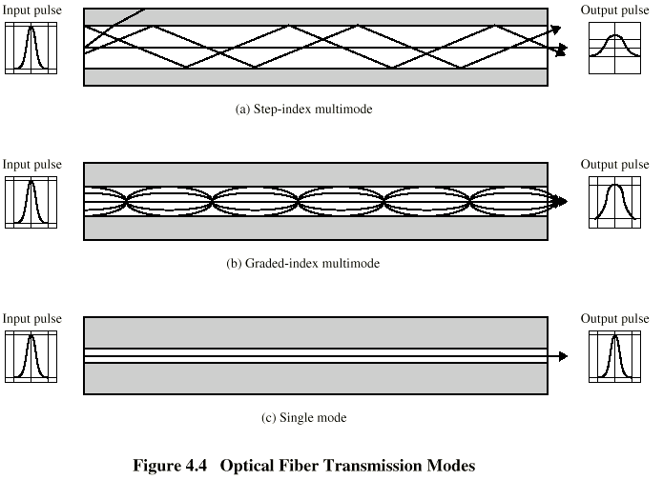
Optical Fiber Transmission Modes

Slide 24
Frequency Utilization for Fiber Applications
Wavelength (in vacuum) range (nm)
Frequency range (THz)
Band label
Fiber type
Application
820 to 900
366 to 333
Multimode
LAN
1280 to 1350
234 to 222
S
Single mode
Various
1528 to 1561
196 to 192
C
Single mode
WDM
1561 to 1620
185 to 192
L
Single mode
WDM

Slide 25
Wireless Transmission Frequencies
2GHz to 40GHz
  Microwave
  Highly directional
  Point to point
  Satellite
30MHz to 1GHz
  Omnidirectional
  Broadcast radio
3 x 10¹¹ to 2 x 10¹⁴
  Infrared
  Local

Slide 26
Antennas
Electrical conductor (or system of..) used to radiate electromagnetic energy or collect electromagnetic energy
Transmission
  Radio frequency energy from transmitter
  Converted to electromagnetic energy
  By antenna
  Radiated into surrounding environment
Reception
  Electromagnetic energy impinging on antenna
  Converted to radio frequency electrical energy
  Fed to receiver
Same antenna often used for both

Slide 27
Radiation Pattern
Power radiated in all directions
Not same performance in all directions
Isotropic antenna is (theoretical) point in space
  Radiates in all directions equally
  Gives spherical radiation pattern

Slide 28
Satellite Microwave
Satellite is relay station
Satellite receives on one frequency, amplifies or repeats signal and transmits on another frequency
Requires geo-stationary orbit
  Height of 35,784km
Television
Long distance telephone
Private business networks

Slide 29
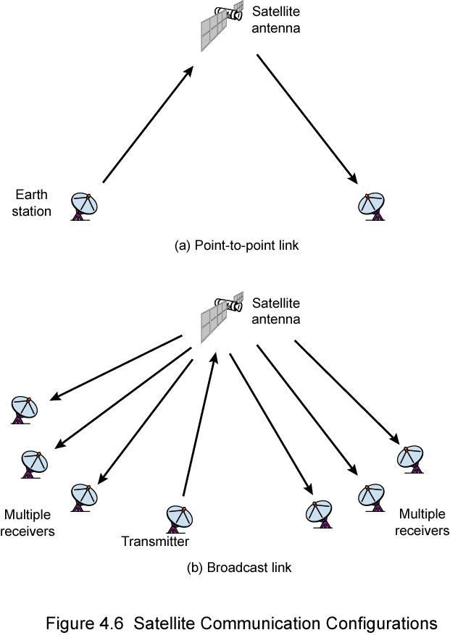
Satellite Point to Point Link

Slide 30
Satellite Broadcast Link

Slide 31
Broadcast Radio
Omnidirectional
FM radio
UHF and VHF television
Line of sight
Suffers from multipath interference
  Reflections

Slide 32
Infrared
Modulate noncoherent infrared light
Line of sight (or reflection)
Blocked by walls
e.g. TV remote control, IRD port

Slide 33
Wireless Propagation
Signal travels along three routes
  Ground wave
    Follows contour of earth
    Up to 2MHz
    AM radio
  Sky wave
    Amateur radio, BBC world service, Voice of America
    Signal reflected from ionosphere layer of upper atmosphere
    (Actually refracted)
  Line of sight
    Above 30Mhz
    May be further than optical line of sight due to refraction
    More later…

Slide 34
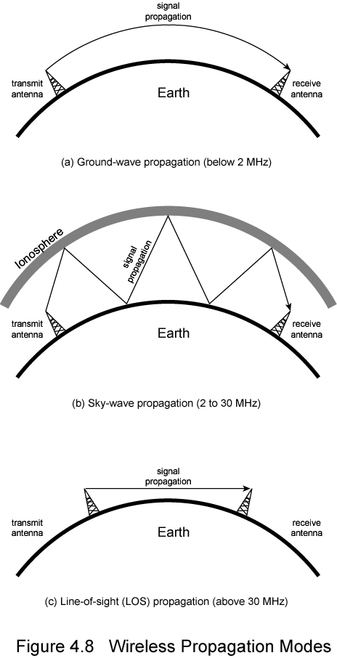
Ground Wave Propagation

Slide 35
Sky Wave Propagation

Slide 36
Line of Sight Propagation

Slide 37
Refraction
Velocity of electromagnetic wave is a function of density of material
  ~3 x 10⁸ m/s in vacuum, less in anything else
As wave moves from one medium to another, its speed changes
  Causes bending of direction of wave at boundary
  Towards more dense medium
Index of refraction (refractive index) is
  Sin(angle of incidence)/sin(angle of refraction)
  Varies with wavelength
May cause sudden change of direction at transition between media
May cause gradual bending if medium density is varying
  Density of atmosphere decreases with height
  Results in bending towards earth of radio waves

Slide 38
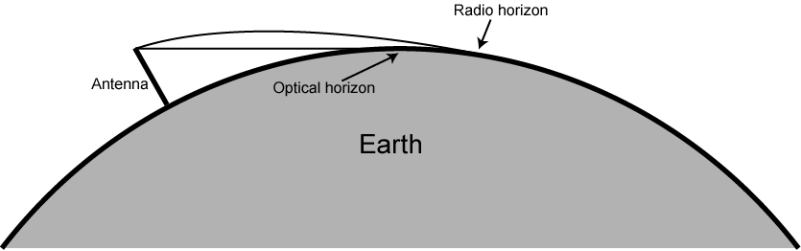
Optical and Radio Horizons

Slide 39
Line of Sight Transmission
Free space loss
  Signal disperses with distance
  Greater for lower frequencies (longer wavelengths)
Atmospheric Absorption
  Water vapour and oxygen absorb radio signals
  Water greatest at 22GHz, less below 15GHz
  Oxygen greater at 60GHz, less below 30GHz
  Rain and fog scatter radio waves
Multipath
  Better to get line of sight if possible
  Signal can be reflected causing multiple copies to be received
  May be no direct signal at all
  May reinforce or cancel direct signal
Refraction
  May result in partial or total loss of signal at receiver

Slide 40
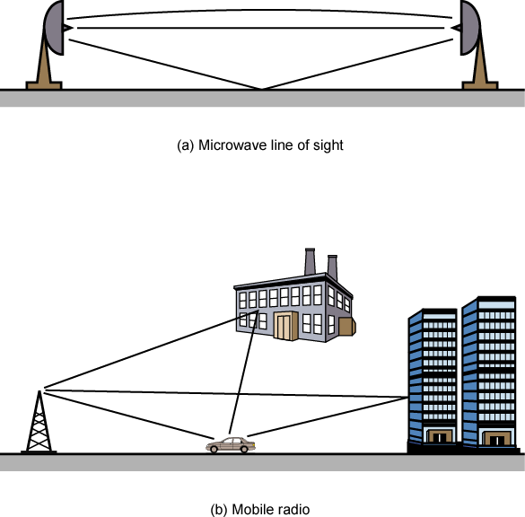
Multipath Interference

